Slide 1

Safecare Insurance
Analysis

Slide 2

AGENDA
Introduction
2. Objective
3. Dataset
4. Requests
5. Insights

Slide 3
Introduction
Safecare Insurance is leading healthcare insurance in India which covers total of 11 hospitals and clinics around Mumbai city

Slide 4
Objective
Safecare has huge claims data of year 2023 for all 11 facility. Stakeholders wants metrics of charges, payment, adjustments and AR of each facility to enhance their operations

Slide 5
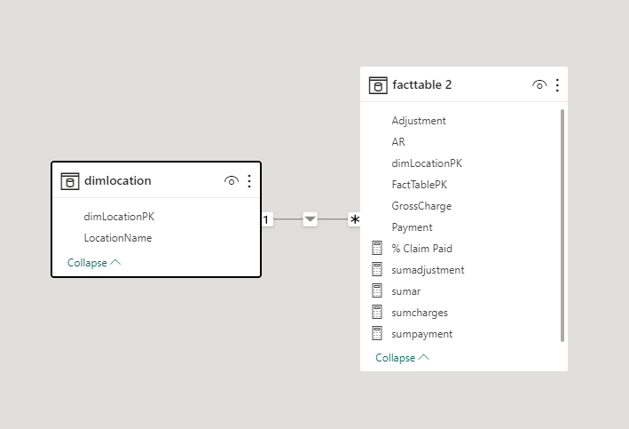


Dataset and modelling
Tools used

Slide 6

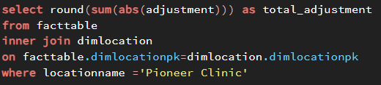
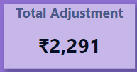

Question 1
Calculate total adjustment of Pioneer Clinic
SQL
Power BI

Slide 7
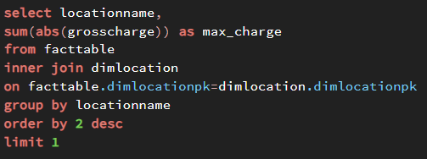


Question 2
Mention facility which has maximum charges
SQL
Power BI

Slide 8
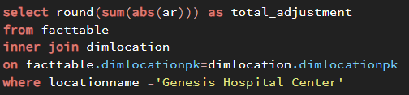


Question 3
Calculate total AR of Genesis Hospital Center
SQL
Power BI

Slide 9
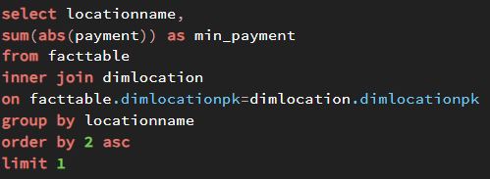


Question 4
Mention facility which has minimum payment
SQL
Power BI

Slide 10
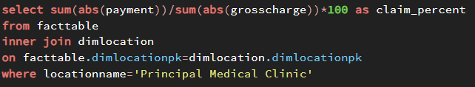

Question 5
Calculate % claim paid of Principal Medical Clinic
SQL
Power BI

Slide 11

Insights
Maximum charges is of Angelstone Community Hospital facility
Total Adjustment cost of Pioneer Clinic is 2,291
Minimum Payment is of Genesis Hospital Center facility
Total AR cost of Genesis Hospital Center is 2,836
Percent Claim paid for Principal Medical Clinic is 47.05%

Slide 12


